Slide 1
Food Processing:
A Necessary Operation
Daryl Lund
Professor Emeritus
University of Wisconsin
Editor in Chief IFT Peer-Reviewed Journals 2003-2012
President International Academy of Food Science and Technology 2012-2014
Chair Scientific Council International Union of Food Science and Technology 2014-2016

Slide 2
IUFoST began its partnership with CMPi (UBM) in 2002
Purpose of the partnership: Complement IUFoST’s scientific expertise and global resource with UBM’s commercial expertise and global reach
Examples of contributions from IUFoST:
Assisted with marketing and communications support for UBM for all global events
Arranged for speaker support and the top executives of IUFoST to attend these events
Provided articles by leading international experts for the Food Ingredients magazine
Provided access to information bulletins in a proprietary manner for UBM e.g. Food Traceability, Food Composition Databases, Dietary Sodium and Health, Regulation of Natural Health Products, Chemical Hazards in Foods, Functional Foods, Food Allergy
At UBM’s request in 2010, added two IUFoST awards to the Hi/Fi Excellence Awards:
IUFoST Lifetime Achievement Award and a Young Scientist Award.

Slide 3
Outline
A bit of history
Processed Food Defined
Food Processing Defined
Disclaimer: These thoughts are generated as someone engaged in food science and engineering activities since 1963 and are therefore not authoritative nor rigorously defendable!

Slide 4
Outline
A bit of history
Processed Food Defined
Food Processing Defined

Slide 5
Food Science and Food Processing is Not a Modern Concept…
They are thousands of years old
  Early forms of food preparation (cooking, smoking, fermenting, drying, salting) provided basic survival
  Domestication of plants and animals; planting and harvesting farming methods developed and refined
  Ancient food technologists in Greece created three major foods—bread, olive oil and wine—through complex processing methods (think kitchen)
And have helped early civilization overcome disease and improve health
  Cooking and Preservation were passed down over generations from important food scientists—moms and grandmas
Notes:
Study of every ancient civilization clearly shows that throughout history humans overcame hunger and disease, not only by harvesting food from a cultivated land, but also by processing it with sophisticated methods. For example, the three most important foods in Ancient Greece—bread, olive oil, and wine—were all products of complicated processing that transformed perishable, unpalatable, or hardly edible raw materials into safe, tasty, nutritious, stable, and enjoyable foods (Floros 2004).
Our food supply has evolved from use of only primitive forms of food processing like simple cooking, to a very complex production-to-consumption system that uses very sophisticated processing methods and technologies which can maintain or enhance food quality and food safety, preserve sensitive nutrients, remove toxins and antinutrients, and which are important to the design of foods for contributing to optimal health and meeting the needs of specific subpopulations, reducing waste and product loss, and distributing foods around the world.

Slide 6
Foraging to Farming to Food Science and Engineering
5
2010
4
1975
World’s population (billions)
3
1960
2
1930
Introduction of Food Science and Engineering
1850
1
Hunter-Gatherer
Agricultural
Industrial
4 million yrs ago
10,000 yrs ago
1800
1900
2010
(Henry, 1997)

Slide 7
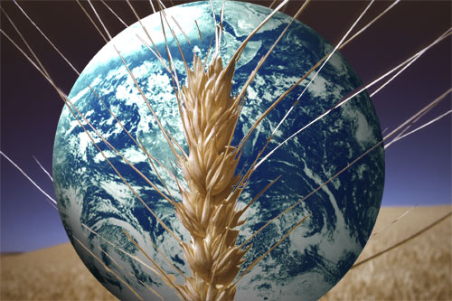
Food in the Future
Today’s global issues will remain
  Food Security
  Water & Other Natural Resources
  Health and Wellness
  Global Food Supply Chain
    Intricacies
    Regulatory Harmonization
  Food Safety
  Sustainability of Food Systems
Notes:
Today’s global food issues will remain with us for some time to come.
Getting food to those that don’t have it today,
Effective use of water and other natural resources,
Providing healthy foods to combat diet and disease,
Intricacies of the global food supply chain including regulating global standards and regulations,
Providing safe food,
And maintaining sustainability of our food systems.

Slide 8
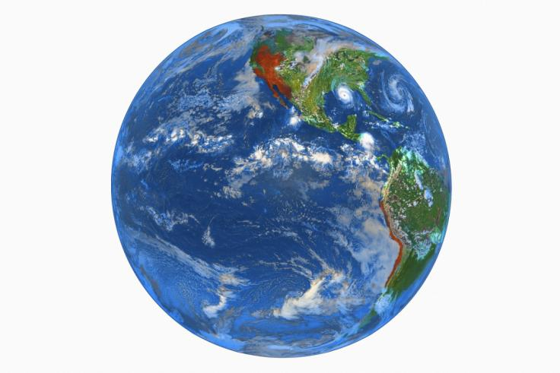
To Feed the Future
We face a growing challenge to feed nearly 7 billion people today…
The expected population growth to 9 to 10 billion people by 2050…
…food science and technology will have to provide critical solutions.
Notes:
Our modern food system is very complex and changes continuously. It is a fact that scientific and technical achievements throughout the food system- from agriculture and food manufacturing to preparation in the home- allow most people in the developed world to have ready access to a diverse, abundant supply of food that is safer, tastier, more nutritious, more convenient, and relatively less expensive than would otherwise be the case. Many people in the developing world however, where a substantial portion of food produced is lost, are not able to make choices from such abundance. Further advances in science and technology are critically needed to successfully meet the daunting challenges ahead in feeding the growing world population, especially in the areas of greatest need.

Slide 9
Modern Day Food Technology is More Complex Than Grandmother’s Practice…
Biology
Engineering
Psychology
Chemistry
Product Development
Animal Science
Sensory
Food Law
Flavor Chemistry
Materials Science
Microbiology
Nutrition
Computer Science
Quality Assurance
Toxicology
Genomics
Packaging
Consumer Science
Notes:
Modern day food technology is very complex pulling together scientists from a multitude of scientific disciplines.
Crucial to these food system successes are food scientists and technologists, whose work is made possible by the integration of the knowledge of many disciplines—from biology and cell biology, to biotechnology, chemistry, computer science, genomics, materials science, microbiology, nutrition, physics, engineering, sensory science, and toxicology (IFT 2010a). Within such an interdisciplinary community, food scientists and technologists can apply scientific and technological advancements and pursue promising technologies on the horizon to overcome the challenges we face, leading to more personalized and environmentally-sensitive solutions than ever before (IFT 2010a).
The thing they all share is a commitment to the science…and the business of food.

Slide 10
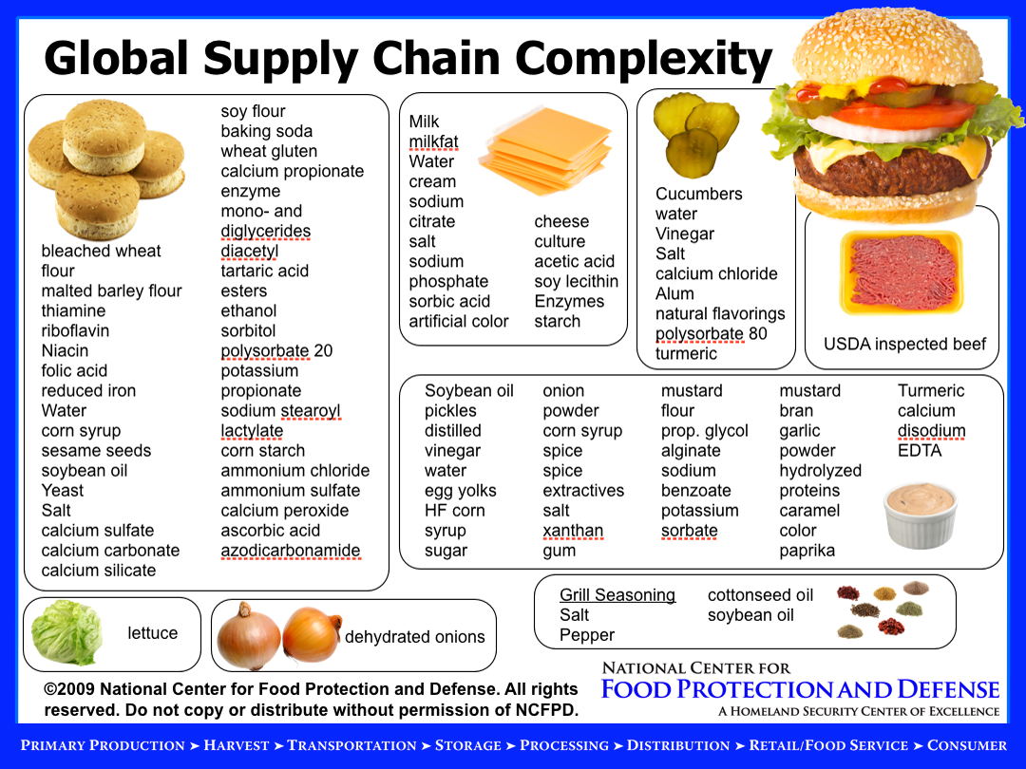
Notes:
Just take a look at all the ingredients that go into making a cheeseburger, courtesy of the National Center for Food Protection and Defense. From the bread to the cheese, to the produce and condiments, to the meat itself. A lot of different ingredients! And you thought all cheeseburgers were the same.
(Pause and look at the slide on the screen)

Slide 11
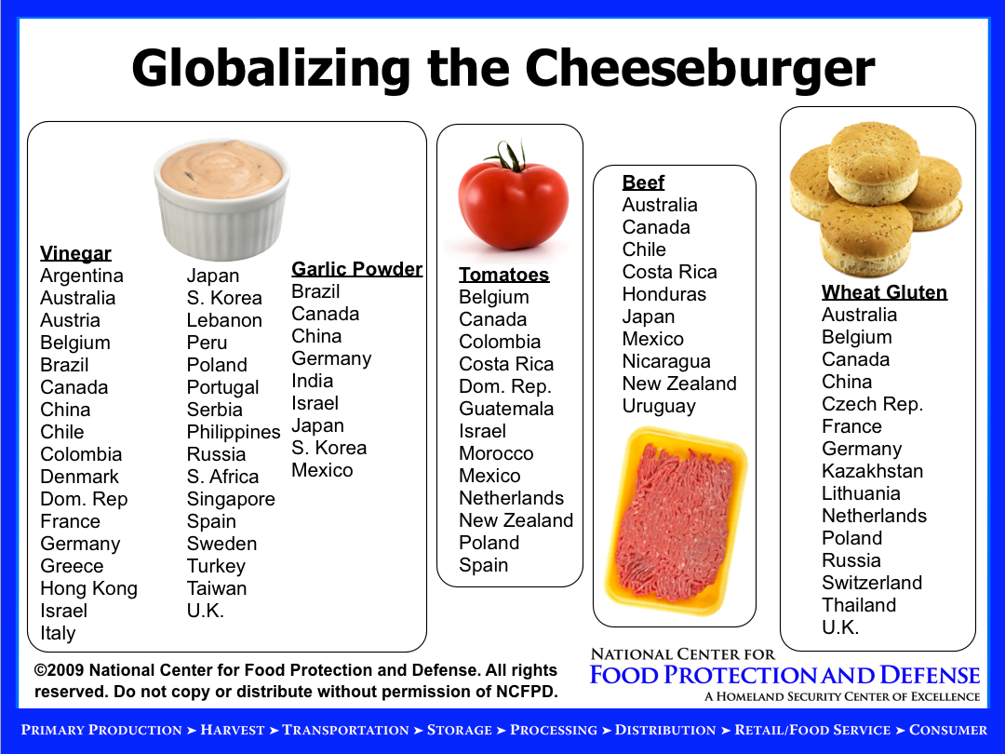

Slide 12
Current Issues on Food Processing
Processed foods are increasingly being blamed for consumer ills (including obesity)
Large scale food processing is hurting local economies
Processed foods are the demise of families since they no longer eat together
Large food companies dictate what is available to consumers

Slide 13
Food Processing and the Food Chain
Series of intricately linked activities from farm to consumer
Essential for nutrients for human health and ultimately for human life
Series of activities within the framework of economic, biological, social and political contexts
Food processing is an integral part of the system

Slide 14
Outline
A bit of history
Processed Food Defined
Food Processing Defined

Slide 15
Definition of Food - FDA
SEC. 201. [21 U.S.C. 321] CHAPTER II—DEFINITIONS
(f) The term "food" means (1) articles used for food or drink for man or other animals, (2) chewing gum, and (3) articles used for components of any such article.
(r) The term "raw agricultural commodity" means any food in its raw or natural state, including all fruits that are washed, colored, or otherwise treated in their unpeeled natural form prior to marketing.
(gg) The term "processed food" means any food other than a raw agricultural commodity and includes any raw agricultural commodity that has been subject to processing, such as canning, cooking, freezing, dehydration, or milling.

Slide 16
What are processed foods?
International Food Information Council Definitions
Processed foods includes, among other things, fresh fruits, vegetables, grains, nuts, eggs, etc. that have been subject to processing, such as canning, cooking, freezing, dehydration, or milling.
Minimally processed foods receive only minimal heat processing or other preservation treatment to ensure their safety from bacteria or other foodborne illness. They are either stored under refrigeration or frozen and require partial cooking or heating by the consumer.

Slide 17
Definitions Continued
Prepared foods consist of one or more foods and/or ingredients that has already been cooked and is either ready to eat as is, or only needs to be heated before consuming. It does not require any additional preparation, such as adding uncooked foods and/or ingredients and cooking or baking before eating. Depending on the foods and/or ingredients in a prepared food, it may or may not need to be refrigerated or frozen after purchasing until the consumer is ready to consume it.
Organic foods are produced with an emphasis on the use of renewable resources and the conservation of soil and water to enhance environmental quality for future generations. Organic products come from animals that are given no antibiotics or growth hormones. Organic food is produced without using most conventional pesticides.

Slide 18
Outline
A bit of history
Processed Food Defined
Food Processing Defined

Slide 19
Objectives of Processing
Make new structures or improve existing structures
Alter sensory properties
Improve nutrient availability
Extend shelf life

Slide 20
Objectives of Processing
Thermal stabilization (preservation) processes
Nonthermal stabilization processes
Cooling and freezing
Dehydration processes
Separation and isolation processes
Chemical and biochemical conversion
Mixing and structuring processes

Slide 21
Objectives of Processing
Make new structures or improve existing structures
Alter sensory properties
Improve nutrient availability
Extend shelf life

Slide 22
Ice Cream
Pasta
Bread
Baked Doughs

Slide 23
Objectives of Processing
Make new structures or improve existing structures
Alter sensory properties
Improve nutrient availability
Extend shelf life

Slide 24
Altering sensory properties
Softening vegetable tissue like carrots
Dulce de leche (caramel)
Producing concentrated syrups
Producing flavors or odors (like coffee)

Slide 25
Objectives of Processing
Make new structures or improve existing structures
Alter sensory properties
Improve nutrient availability
Extend shelf life

Slide 26
Adding Health Attributes to Foods
Fortification of Foods
Iodization of salt
Vitamin D fortification of fluid milk
Enrichment of flour
  Thiamin, riboflavin, niacin and iron
fortification of RTE cereals
Addition of folate to the enrichment formula
Addition of other bioactives, e.g., phytosterols

Slide 27
Objectives of Processing
Make new structures or improve existing structures
Alter sensory properties
Improve nutrient availability
Extend shelf life

Slide 28
Processing Technologies for Extending Shelflife
Traditional
Canning
Drying
Freezing
Fermenting
Packaging

Slide 29
Newer Processing Technologies
(or not used extensively)
Irradiation
High Pressure
Ultrasonics
High intensity light
Nanotechnology
Pulsed electric fields
Plasma discharge

Slide 30
Public and Private Sector
Developments supported significantly by the private sector
Clear rationale for the role of public investment in advancing knowledge and application of food technologies
Healthy and well-fed population
  less strife, more productive work force and more enlightened populous

Slide 31
“Older” Methods of Food Preservation
Canning
Refrigeration/freezing
Drying
Chemical preservation

Slide 32
Older Food Preservation Technologies
Canning
In Container-Appert 1800s
Prep product Pretreatment Fill Seal Thermal process
Aseptic-1950s
Prep product Pretreatment Thermal process Fill Seal
Freezing
1800s Ice with salt, covered with saw dust
1900s Mechanical refrigeration (NH3-ammonia)
1930s Frozen Foods Birdseye
1960s Flash freezing (liquid N2)
1970s Individual Quick Freezing (IQF)

Slide 33
Older Food Preservation Technologies
Drying
Oldest Preservation Technique
Sun drying
Salt drying
Hot air drying
Inert gas drying (CO2, N2)
Freeze drying
Microwave-assisted drying

Slide 34
Chemical Methods
Fermentation
Salt(s)
pH (lemon on apple slices)
Advances to improve the efficiency and effectiveness proceeding at a rapid rate.
Basis: To reduce microbiological growth and metabolism and prevent undesirable chemical changes in foods

Slide 35
Minimizing Microbial Spoilage
Processes to inactivate microorganisms
Good manufacturing practices, sanitation, and hygiene
Concept of hurdle technologies
  Stabilize food either in parallel or sequentially

Slide 36
“Hurdles” and Food Preservation
Barriers to microbial growth and deterioration/destabilization of food Examples: heating, chilling, water activity control, pH, oxidation-reduction potential, preservatives
A combination of hurdles result in preservation of food material

Slide 37
Hurdle-preserved foods
Hurdles | Cottage cheese | MAP packaged salad
Low temp | X | X
High acidity | X
Low redox pot |  | X
Preservatives | X
Modified gas atmosphere |  | X
(Leistner and Gorris, 1995)

Slide 38
Newer Food Technologies
Nonthermal in nature
  Do not involve significant elevation or reduction of temperature

Slide 39
Pulsed Electric Fields
  Mode of action is primarily through lysis of the microbial cell
  To inactivate enzymes and microorganisms demonstrated in the 1960’s
  Pulses generally on the order of microseconds with rapid cycling (5–10 Hz)

Slide 40
Pulsed Electric Field Applications
Product | Maximum inactivation, log reduction
Orange juice | Shelf life extension from 3 days to 1 wk, (5D reduction)
Milk | 3D reduction
Liquid egg | 6D reduction

Slide 41
Pulsed Light Technology
Intense exposure of a product to simulated sunlight
Microbial cell directly exposed to light pulse
Greatest effect on surfaces of packaging materials or smooth, regular surfaces

Slide 42
Food Irradiation
Long history of active promotion to increase shelf life and ensure food safety,
Does not have wide acceptance with consumers
Increased attention/attraction with outbreaks associated with E. coli 0157:H7 and species of Salmonella

Slide 43
High Pressure Technology
Century old idea
Commercial adoption is expanding
High pressure processed foods have been available in Japan since 1990
Pressures are on the order of 100-1000 MPa (1 to 10 kbar)

Slide 44
High Pressure Technology
Shelf life extension
Prevent Microbial Contamination
Develop new foodstuffs
Manufacture partially cooked foods

Slide 45
Packaging One of the oldest methods to extend shelf life of food
Milk stored in calf stomach (cheese)
Food cache (underground)
In the ice
Banana leaves
Cardboard (variability of properties)
Plastics
Flexible film
Hard plastics (plastic cans)
Tubes (like toothpaste)
Aluminum foil

Slide 46
Active Packaging
Packages which actively change the internal atmospheric composition during storage and distribution
Techniques rely on oxygen, moisture, CO₂ and ethylene absorbers, moisture regulators, and CO_{2 ,}and ethanol emitters, antimicrobial agents and antioxidants incorporated in packaging materials

Slide 47
Smart Packaging
Systems in which information is provided to consumer to indicate product abuse and product quality
Time-temperature indicators to provide information on thermal abuse of foods

Slide 48
Indicators in Smart Packages
Technique | Principle | Application
Time Temperature indicators | Mechanical, chemical, enzymatic | Chilled, frozen foods
O₂ indicators | Redox dyes pH dyes | Reduced O₂ storage
Microbial growth | pH dyes | Aseptic products
(Ahvenianen and Hurme, 1997)

Slide 49
Nanotechnology in Food Science/Engineering
Heat/mass transfer
Biotechnology
Food Safety
Emulsions
Biosecurity
Packaging

Slide 50
Nanotechnology: Enhanced Functionality
Multiscale assemble of food components
Polymers, Particles, Phases
Active ingredients
Sensory attributes
Controlling digestion through food structure
Molecular gastronomy-Food design

Slide 51
Industry’s and Consumers’ Questions
  • Is it safe?– People will eat it!
    Are materials Generally Recognized as Safe (GRAS)
    Does toxicity change at the nanoscale?
  What are the environmental impacts?
  Worker safety?

Slide 52
Human Stomach—the Ultimate Food Processor
R. Paul Singh
University of California, Davis
www.rpaulsingh.com

Slide 53

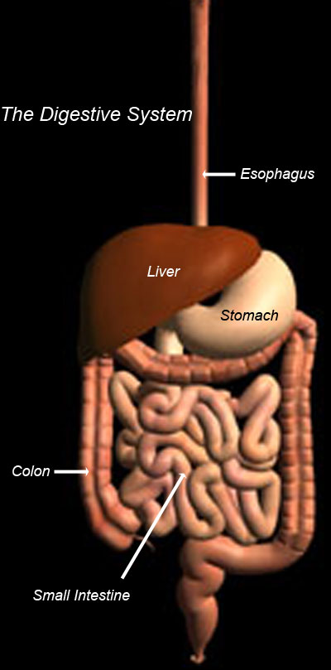

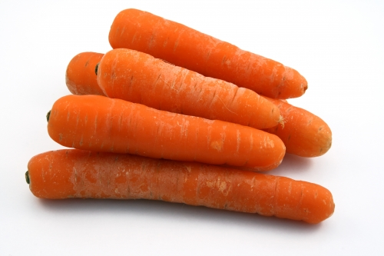

  Link between physical and material properties of foods and nutrient release from foods in the GI tract?
Role of Food Material Properties and Disintegration Kinetics in Gastric Digestion USDA NRI 2008-12

Slide 54
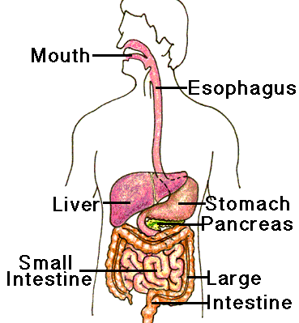
Digestion system
The overall function
  extract nutrients into useable form
  absorb nutrients
  eliminate unneeded materials
Food takes between 24-36 hours to pass through the gastrointestinal tract
Solid Food Disintegration in the Stomach
-Stomach emptying
-Satiety, Obesity
-Nutrient release
-Food safety:
- Allergens
-Nanoparticles

Slide 55
Develop a realistic computer-aided model of the human stomach and study flow characteristics and solid disintegration

Slide 56
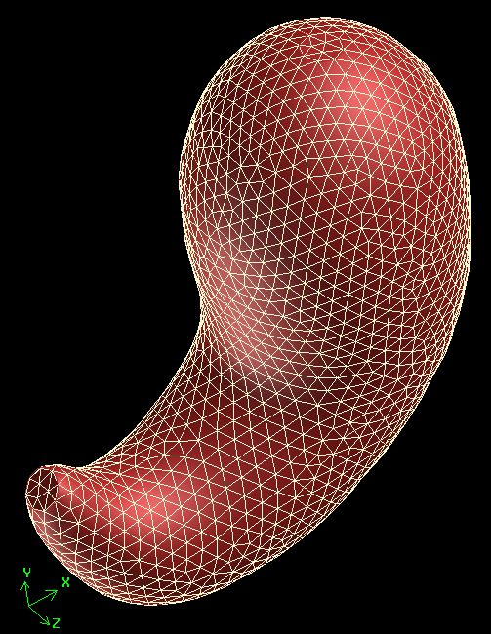
3D MODEL-AVERAGE SIZED HUMAN STOMACH
Average dimensions*
  Greater curvature ≈ 31 cm long.
  15 cm wide (at its widest point).
  Pylorus’ diameter is ≈ 1 cm.
  Stomach’s capacity is about 0.94 L.
Volume = 0.9 L
Max width = 10 cm
Pylorus diameter 1.2 cm
  * Keet, 1993; Schulze, 2006.
Max curvature = 34 cm

Slide 57
ANTROPYLORIC FLOW MOTION
Effect of viscosity on the formation of the retropulsive jet-like structure.
v_{max} = 2.8 cm/s
v_{max} = 4.0 cm/s
v_{max} = 3.6 cm/s
No retropulsive jet-like structure developed.
Higher and more localized retropulsive velocities were predicted at the peak of the ACW.

Slide 58
Carrot disintegration
Disintegration profiles of carrot (n=6)
Hardness of carrot in gastric juice (n=8)
The different profiles are a result of competition among surface erosion, texture softening and absorption of gastric juice

Slide 59
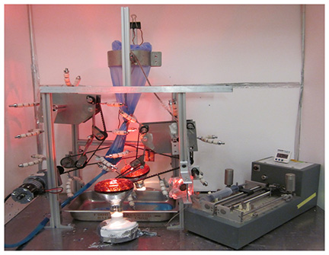
Human Gastric Simulator (HGS-1)
Patent Pending

Slide 60
Food Structure, textural properties and digestion

Slide 61
Research Directions
Diet, Food and Health Connection understanding the relationship between what we eat and acute and chronic disease
Molecular Mechanisms of Reaction understanding at the molecular level the reactions that are important (pertaining to health, well-being, food deterioration, etc.)
Nutraceuticals/Functional Foods enhancing health through ingestion of chemicals that have biological and physiological function

Slide 62
Research Directions
Nanotechnology ability to manipulate atoms and single molecules to produce desired effects.
Atomic Structures understanding structures at the atomic level including food systems and packaging
Food Safety increased understanding of the cause of food intoxication and contamination that increase health risk

Slide 63
Research Directions
Real-Time Analysis development of on-line, real time analytical procedures for detection of chemical and biological agents causing health risk.
Food preservation Optimization continued improvements in traditional preservation technologies for increased quality shelf-life and safety of foods

Slide 64
Research Directions
Non-Traditional Processes introduction of newer technologies such as irradiation, high pressure, high intensity light, pulsed electric fields, ultrasound, and ohmic heating
Sensory Analysis/Consumer Perception increased understanding of stimuli and methods of measuring responses of sensory organs and integrated perceptions of food

Slide 65

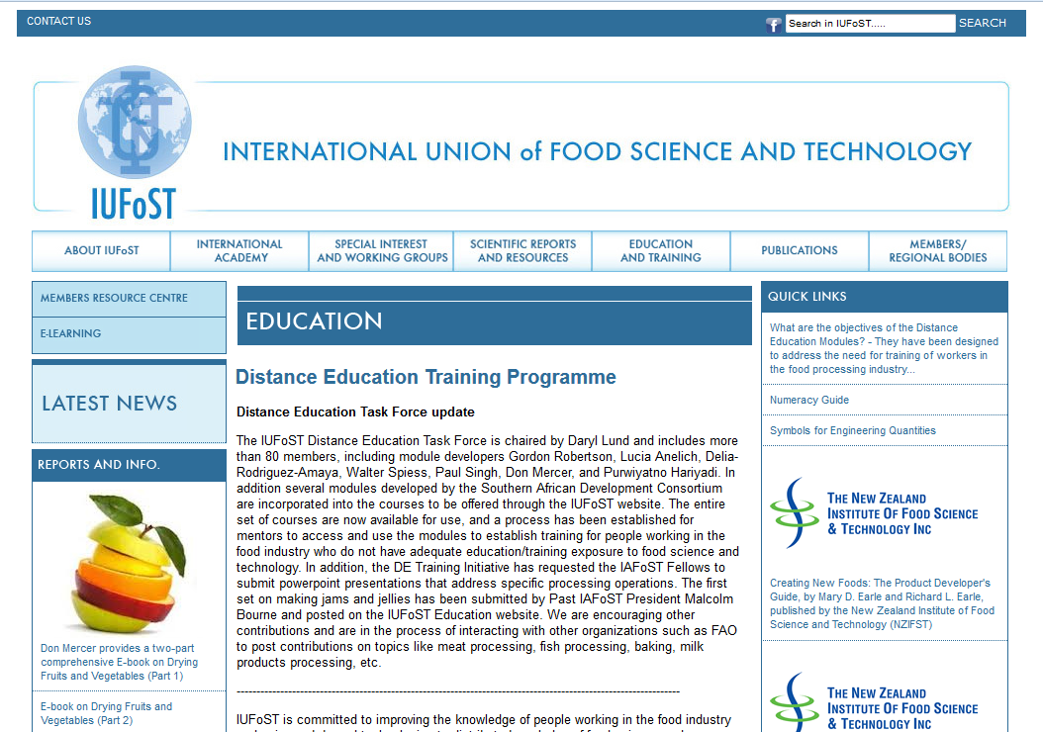
Strengthening Global Food Science and Technology for Humanity www.iufost.org

Slide 66
Mentors and Participants Resources - Step by Step Guide to the E-Learning Site
E-Learning Guide to Course Modules, Manuals and Assignments
E-Learning Guide for Mentors Marking Assignments
E-Learning Guide to find Additional Resources
E-Learning Step by Step for Mentors Emailing other Mentors
E-Learning Tools for Mentors Emails

Slide 67
Thank you!
dblund@wisc.edu

